Slide 1



Slide 2

KIPP Baltimore
Mission: The mission of KIPP Baltimore is to create and operate public schools in Baltimore City that lead students from low socioeconomic backgrounds and a diversity of skill levels to attend and succeed in four-year colleges and beyond.

Slide 3
KIPP Baltimore
Vision: KIPP Baltimore board and staff members and students and their families work hard to bring about the time when all schools in Baltimore will be committed to doing whatever it takes to lead all students to attain the values, knowledge, skills, and habits necessary to live and work in ways that afford them power, freedom, and choices and that make our city, country, and world better places for all people.

Slide 4
KIPP Baltimore Values
F.I.R.E.
Fun
Improvement
Relationships
Excellence

Slide 5


KIPP Founding
KIPP Academy Houston
KIPP Academy South Bronx
1994 -- Mike Feinberg and Dave Levin launched a fifth-grade public school program in inner-city Houston, TX
1995 – Creation of KIPP Academy Middle School, and KIPP Academy South Bronx
2000 – Formation of the KIPP Foundation with the generous support of Don and Doris Fisher

Slide 6
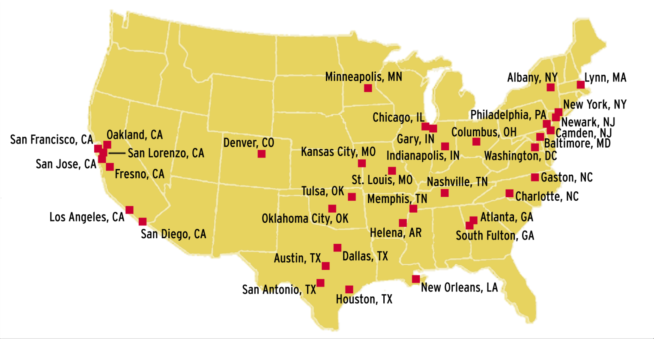
The KIPP Network – Geographic Reach
With schools in almost every major area of the country, KIPP has the most expansive national footprint of college-preparatory public schools in the U.S. There are currently 99 KIPP public schools in 20 states and the District of Columbia enrolling around 26,000 students.

Slide 7
KIPP Core Operating Principles:
The Five Pillars
High Expectations -- KIPP schools have clearly defined and measurable high expectations for academic achievement and conduct that make no excuses based on the students' backgrounds.
Choice and Commitment -- No one is assigned or forced to attend a KIPP school. Everyone must make and uphold a commitment to the school and to each other to put in the time and effort required to achieve success.
More Time – KIPP students are in school on average more than 50% more time than their traditional public school peers.
Power to Lead – KIPP School Leaders have control over their school budget and personnel.
Focus on Results -- KIPP schools relentlessly focus on high student performance on standardized tests and other objective measures.

Slide 8
KIPP Baltimore Schools
KIPP Ujima Village Academy (KUVA)
4701 Greenspring Avenue, Baltimore City
Opened in 2002
Grades 5-8
Currently serves 385 students in 2010-11
KIPP Harmony Academy (KHA)
2810 Shirley Avenue, Baltimore City
Opened in August 2009
Currently grades K-1; will grow to K-4
Currently serves 250 students in 2010-11; will serve 600

